Slide 1
Concurrency control in Distributed Transactions

Slide 2
1. Introduction
Concurrency control in distributed transactions ensures global serializability—transactions are serialized consistently across all servers. Each server enforces local concurrency control (e.g., locking, timestamp ordering, optimistic methods), but coordination is required to avoid conflicts and deadlocks.

Slide 3
2.Locking in Distributed Transactions
Local Locking: Each server manages locks independently. For example:
  Transaction T locks object A at Server X.
  Transaction U locks object B at Server Y.
Distributed Deadlocks: Arise when transactions hold locks at different servers in conflicting orders.

Slide 4
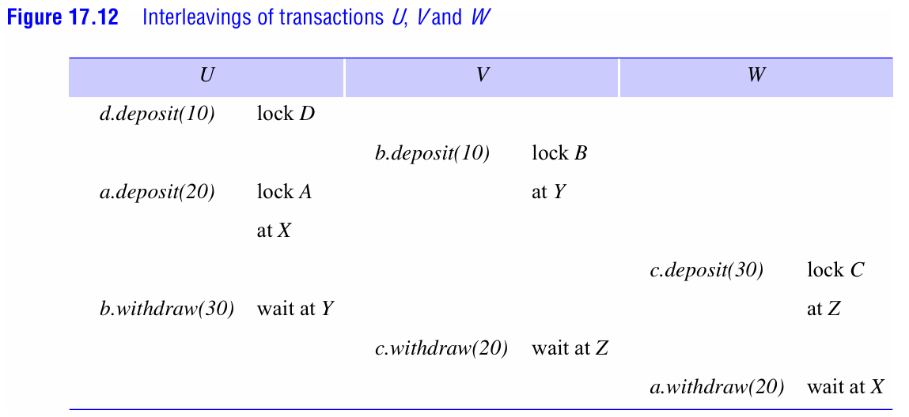

Slide 5
2.Locking in Distributed Transactions
Example (Figure 17.12):
T locks A → U locks B → T waits for B → U waits for A → Deadlock cycle (T→U→T).
Edge-Chasing Algorithm (Distributed Deadlock Detection):

Slide 6
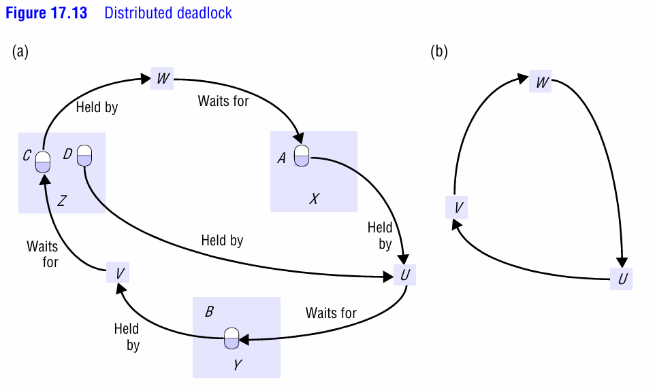

Slide 7
2.Locking in Distributed Transactions
Servers exchange probes to detect cycles in the global wait-for graph (Figure 17.13). If a cycle is found, one transaction is aborted.

Slide 8
3. Timestamp Ordering
Globally Unique Timestamps: Each coordinator generates timestamps with <local timestamp, server-id> to ensure uniqueness.
  Conflicts resolved by timestamp order (e.g., write from a later transaction aborts an earlier one).
Example:
If transaction T (timestamp t1) writes to object A, and transaction U (timestamp t2 > t1) tries to read/write A, U is aborted.

Slide 9
4. Optimistic Concurrency Control
Validation During Commit:
Transactions validate during the first phase of 2PC.
  Parallel Validation: Multiple transactions validate simultaneously but check for conflicts (rule 3: write-write overlaps).
  Global Transaction Numbers: Coordinators agree on a global order to serialize commits (prevents inconsistent validation across servers).
Example:
Transactions T and U validate at servers X and Y. If X validates T first and Y validates U first, a commitment deadlock occurs. Global transaction numbers enforce a consistent commit order.

Slide 10
5. Challenges and Solutions
Global Serializability: Ensure all servers agree on transaction order.
  Locking: Requires strict two-phase locking and deadlock detection.
  Timestamp Ordering: Synchronized clocks or agreed-upon global timestamps.
  Optimistic: Global validation or transaction numbers.
Distributed Deadlocks: Detected via edge-chasing; resolved by aborting transactions.
Phantom Deadlocks: False cycles due to delays or aborts. Addressed by timeouts and probe queues.

Slide 11
6. Hierarchical vs. Flat Protocols
Flat 2PC (Preferred by Moss [1985]):
Coordinator communicates directly with all participants. Uses an abortList to exclude orphaned subtransactions.
Hierarchical 2PC:
Messages propagate through nested transaction trees. More complex but reduces dependency tracking.

Slide 12
Summary
Locking: Simple but prone to deadlocks; edge-chasing detects cycles.
Timestamp Ordering: Requires global agreement but avoids deadlocks.
Optimistic: High concurrency but risks validation conflicts; global coordination needed.
Key Diagrams: Wait-for graphs and interleaved transactions illustrate distributed deadlocks and validation conflicts.

